Slide 1

Mobile payments, without a hitch.

Slide 2


Brian O’Connor
@brian_legendary
Design, Mobile Apps
Scott Hankinson
@slalomshanks
API, Facial Recognition

Slide 3
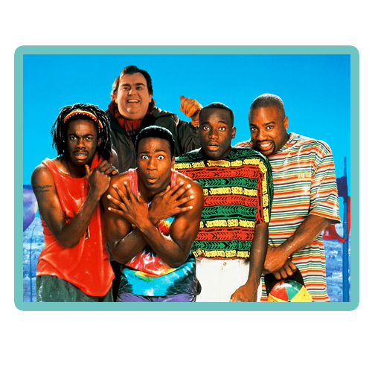

Brian O’Connor
@brian_legendary
Design, Mobile Apps
Scott Hankinson
@slalomshanks
API, Facial Recognition

Slide 4
About a week ago at Starbucks…

Slide 5
Enables checkout without having to touch your phone
Security
Device
Fingerprint
Facial Recognition

Slide 6
Demo

Slide 7







The nerdy stuff...

Slide 8
Mobile payments, without a hitch.

Slide 9
Appendix

Slide 10
Combined Statistics:
Coffees: 9
Hours of sleep: 5.25
Lines of code written
Front End: 797
Back End: 106
Hours in this building: 38
https://github.com/gtg489w/GlobalPaymentsHackathon

Slide 11
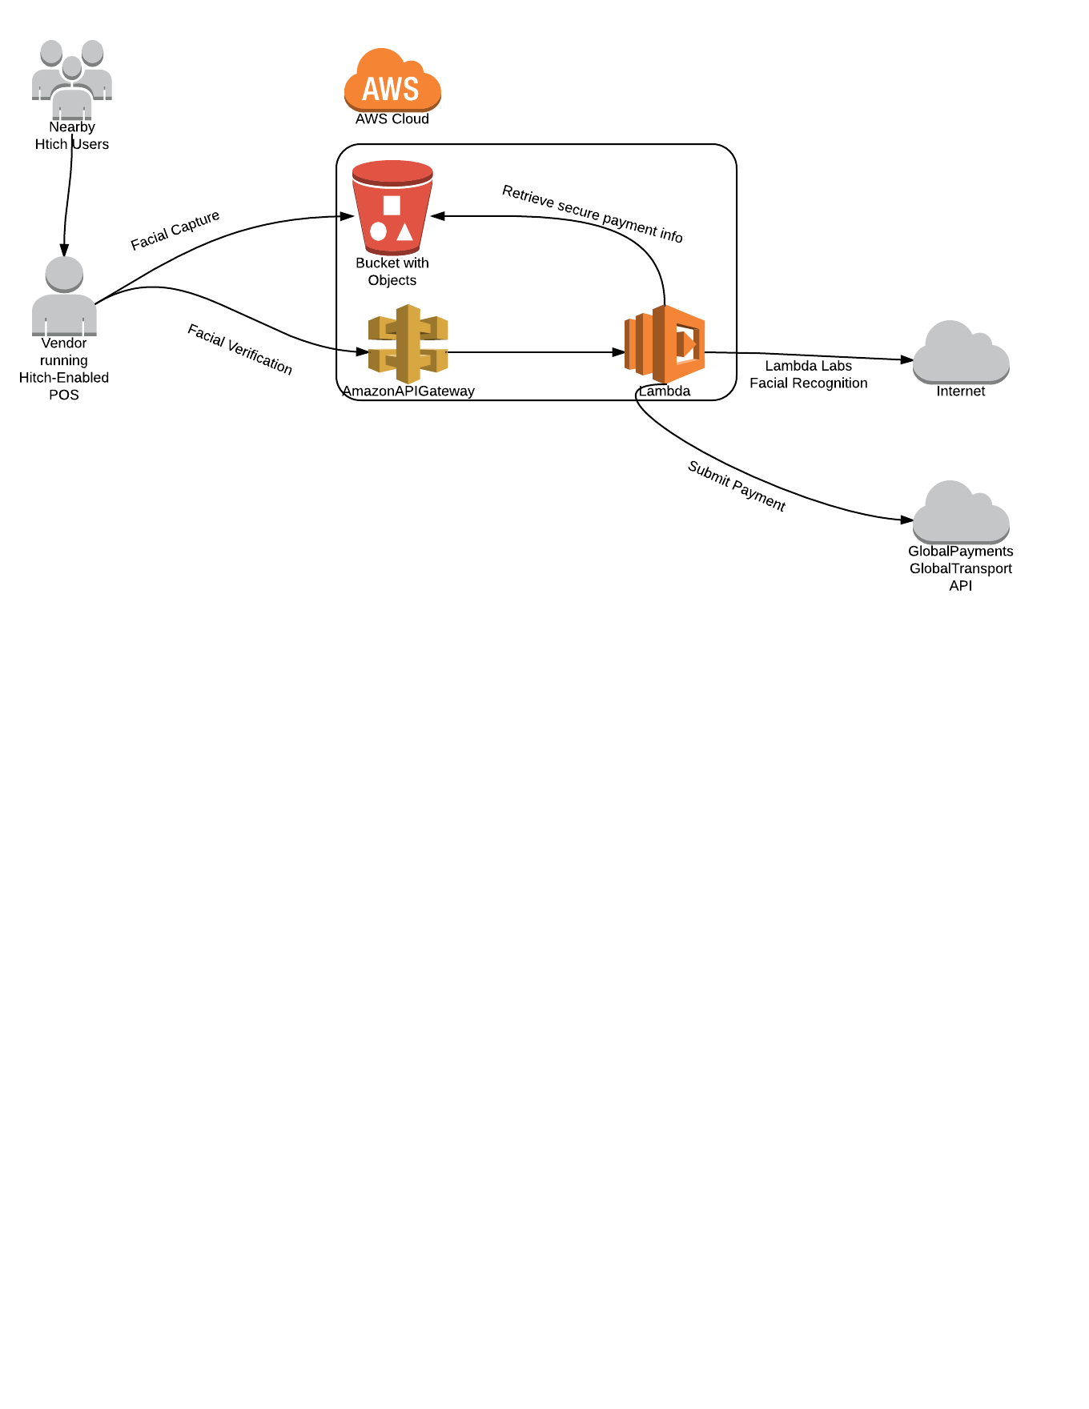

Slide 12
Services Catalog
Front-end
AngularJS
Ionic
Cordova
Back_end
Lambda-Labs Facial Recognition API
AWS API Gateway
AWS Lambda
AWS S3

